Slide 1
Basic Programming in C Extracurricular
Intro to C programming (Header file, variable, constant, data type)

Slide 2
Outline
Header file
Variable
Constant
Data type

Slide 3
SHOWCASE

Slide 4
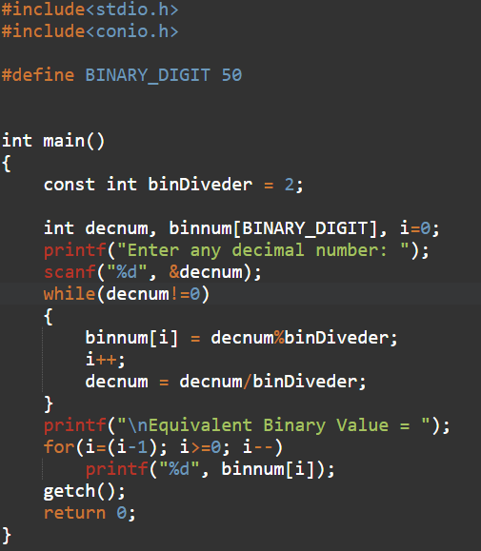
Header File
A header file is a file with extension .h which contains C function declarations and macro definitions to be shared between several source files.
There are two types of header files: the files that the programmer writes and the files that comes with your compiler.

Slide 5
Header File
A header file is a file with extension .h which contains C function declarations and macro definitions to be shared between several source files.
There are two types of header files: the files that the programmer writes and the files that comes with your compiler.

Slide 6
Variable
A variable is nothing but a name given to a storage area that our programs can manipulate. Each variable in C has a specific type, which determines the size and layout of the variable's memory; the range of values that can be stored within that memory; and the set of operations that can be applied to the variable.

Slide 7
Variable
A variable is nothing but a name given to a storage area that our programs can manipulate. Each variable in C has a specific type, which determines the size and layout of the variable's memory; the range of values that can be stored within that memory; and the set of operations that can be applied to the variable.

Slide 8
Constant
Constants refer to fixed values that the program may not alter during its execution

Slide 9
Constant
Constants refer to fixed values that the program may not alter during its execution

Slide 10
Data Type
Data Type | Memory (bytes) | Range | Format Specifier
short int | 2 | -32,768 to 32,767 | %hd
unsigned short int | 2 | 0 to 65,535 | %hu
unsigned int | 4 | 0 to 4,294,967,295 | %u
int | 4 | -2,147,483,648 to 2,147,483,647 | %d
long int | 4 | -2,147,483,648 to 2,147,483,647 | %ld
unsigned long int | 4 | 0 to 4,294,967,295 | %lu
long long int | 8 | -(2^63) to (2^63)-1 | %lld
unsigned long long int | 8 | 0 to 18,446,744,073,709,551,615 | %llu
signed char | 1 | -128 to 127 | %c
unsigned char | 1 | 0 to 255 | %c
float | 4 |  | %f
double | 8 |  | %lf
long double | 16 |  | %Lf

Slide 11
Thank you
Hidayaturrahman@binus.ac.id

